Slide 1


Non-adiabatic excited state molecular dynamics: Identification, monitoring and freezing normal modes Sebastian Fernandez-Alberti

Slide 2
Photoinduced dynamics
in
multichromophoric conjugated molecules
Non-adiabatic EXcited-state molecular dynamics (NEXMD)
Vibrational energy redistribution during electronic relaxation
State-specific vibrations
Vibronic couplings
Identification of active normal modes during intramolecular energy transfer
Vibrational relaxation pathways
"Non-adiabatic Excited State Molecular Dynamics: theory and applications for modeling photophysics in extended molecular materials" T. Nelson, et al., Chem. Rev., 120, 4, 2215-2287 (2020).

Slide 3
NEXMD
(Non-adiabatic EXcited-State Molecular Dynamics)
Energies, gradients, and vibronic couplings between multiple electronic excited states calculated “on the fly” .
Configuration interaction singles (CIS) using the Collective Electronic Oscillator (CEO ) at AM1 level.
Ground state conformational sampling at constant temperature
→ Fotoexcitation and ultrafast dynamics in the excited states
Surface Hopping,
Ehrenfest (Mean Field)
Multiconfigurational Ehrenfest
Cloning
“NEXMD Software Package for Non-adiabatic Excited State Molecular Dynamics Simulations” W. Malone et.al., J. Chem. Theory Comput. 16, 9, 5771–5783 (2020)
LANL Github: https://github.com/lanl/NEXMD
Notes:
Within the NA-ESMD framework^{1,,}, direct nonadiabatic molecular dynamics simulations can be applied to describe photoinduced dynamics in large organic conjugated molecules involving multiple coupled electronic excited states.
Herein we briefly summarize the NA-ESMD theoretical framework.
The electronic energies, gradients, and nonadiabatic coupling vectors were calculated on the fly during the molecular dynamics simulations.
Configuration interaction singles (CIS) level using the collective electronic oscillator (CEO) code22 combined with the Austin model 1 (AM1) Hamiltonian.46

Slide 4
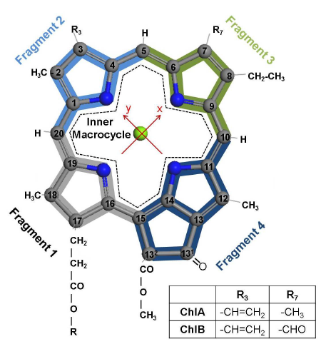
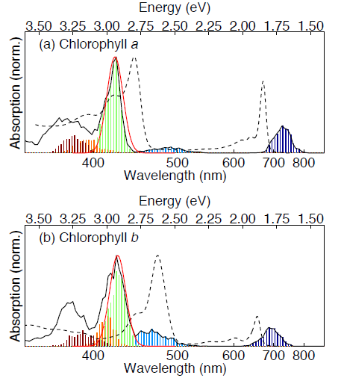
Electronic and vibrational energy relaxation and redistribution
in
Chlorophylls
Light-harvesting (beginning of photosynthesis)
Internal conversion processes following photoexcitation
Under ambient light conditions, a relatively rapid decay to the S₁ is essential to initiate the inter-molecular excitation energy transfer
B → Q_{x} → Q_{y}

Slide 5
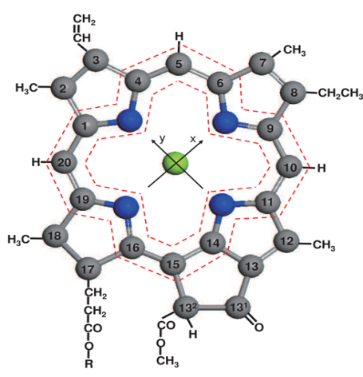
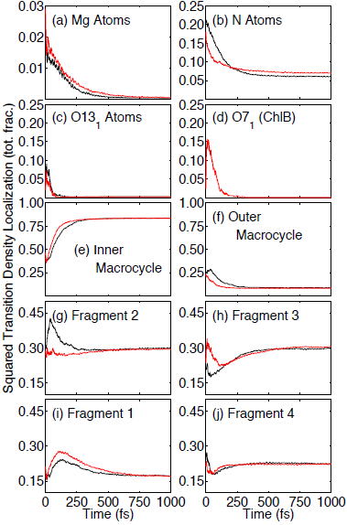
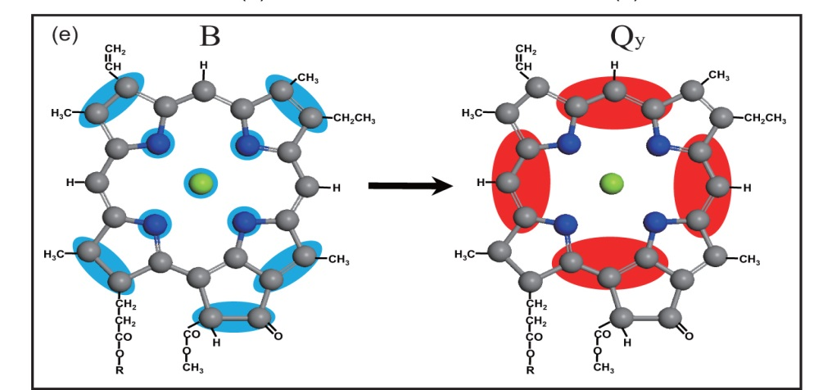
Chl a and Chl b :
Intramolecular Electronic Transition Density Redistribution
ChlA
ChlB

Slide 6
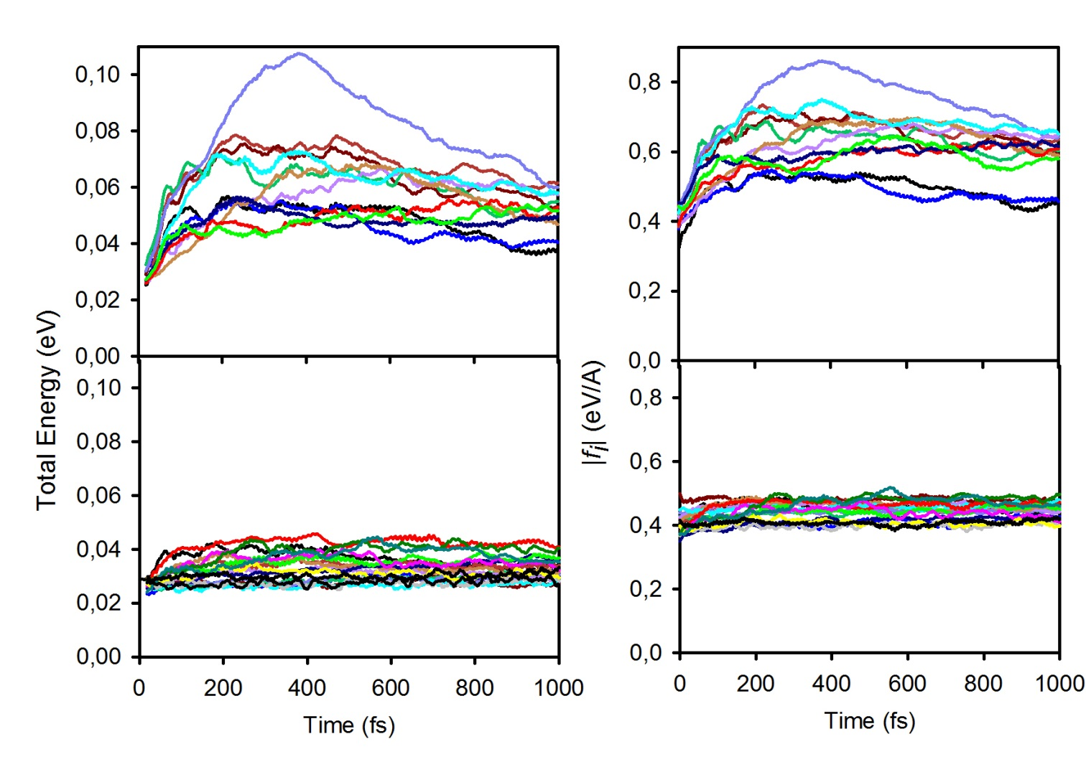
Intramolecular Vibrational Energy Redistribution
monitored by evaluating individual normal mode energies
Active modes
The intramolecular vibrational energy redistribution is not statistical
Active modes: they experience a transient accumulation of excess of energy and
related to the direction of the non-adiabatic coupling vector (overlap) and different intramolecular energy relaxation pathways.
The rest of the modes
act as a bath
≈ 10-12 middle-high frequency modes are active
(less than 5% of vibrations)
"Internal Conversion and Vibrational Energy Redistribution in Chlorophyll A”, P. M. Shenai, S. Fernandez-Alberti*, W. P. Bricker, S. Tretiak, and Y. Zhao, J. Phys. Chem. B 120(1), 49-58 (2016).

Slide 7
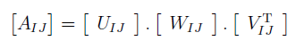

Intramolecular Vibrational Energy Redistribution
Representative vectors of the paths
Singular Value Decomposition of A_{IJ} (3NxK) built with columns representing the d_{ij} vectors of the K NEXMD simulations
The SVD vectors $u_{}^{i}IJ$with the highest $w_{}^{i}IJ$are considered representatives of the original d_{ij} vectors.

Slide 8
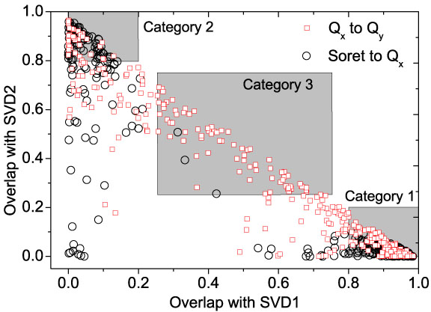
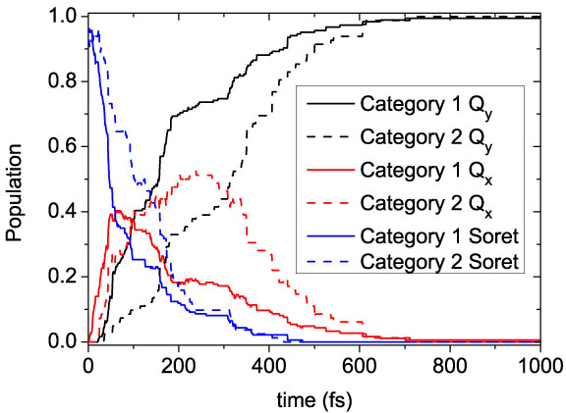
Intramolecular Vibrational Energy Redistribution
Two different pathways
d_{IJ} overlap more than 80% with SVD1
d_{IJ} overlap more than 80% with SVD2
d_{IJ} as a mixture of SVD1 and SVD2
The distribution of active modes that participate in each path is different
Despite the large number of degrees of freedom in the molecule, only a few of them are active and they correspond to those involved in the direction of d_{IJ} and they are different for the different relaxation pathways

Slide 9
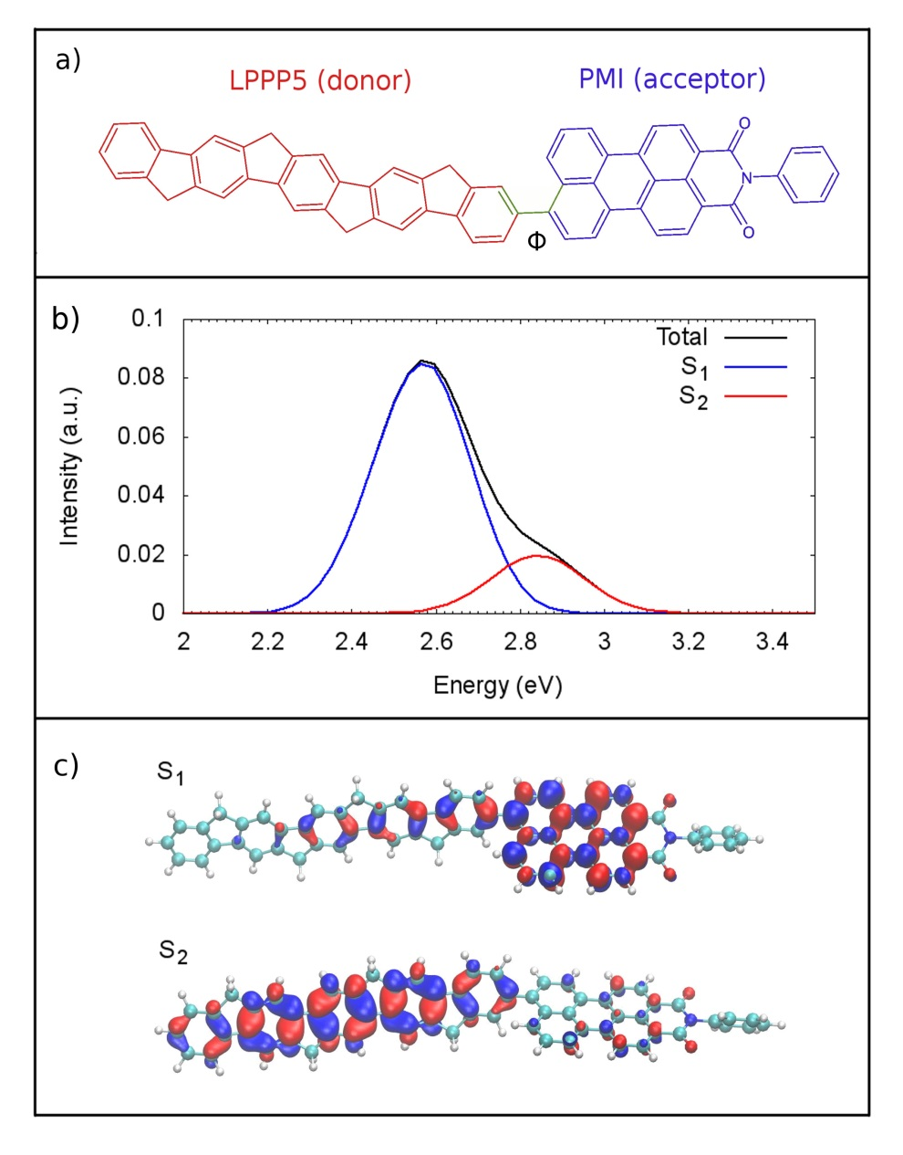

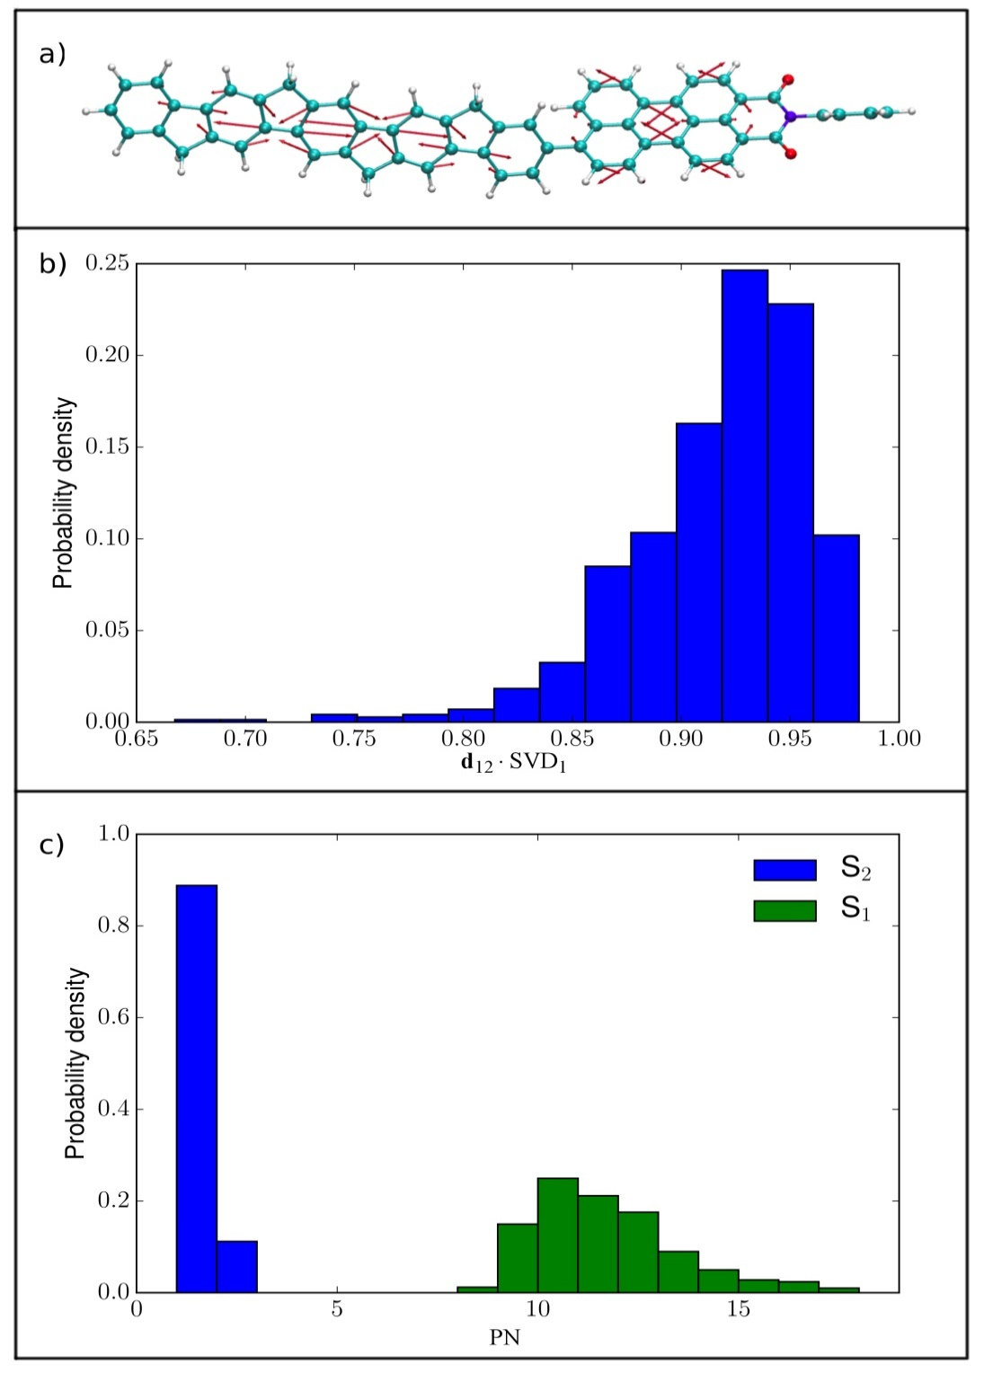
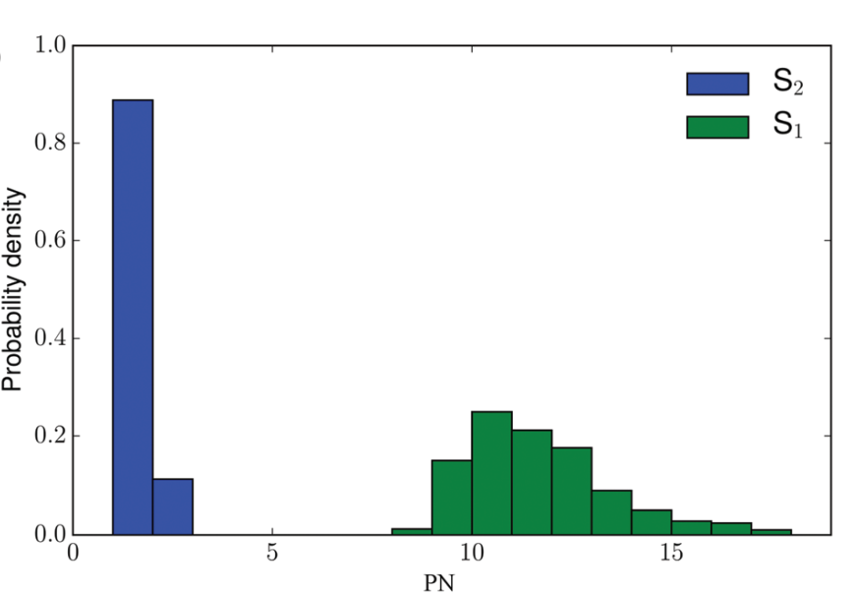
Vibrational energy redistribution during donor-acceptor electronic energy transfer:
only a few normal modes participate actively during the electronic relaxation
Non-adiabatic coupling vector (NACR)
Projection of NACR on the basis of
Excited-State Normal Modes (ES-ENM)
calculated on
S₁ and S₂
Potential Energy Surfaces

Slide 10
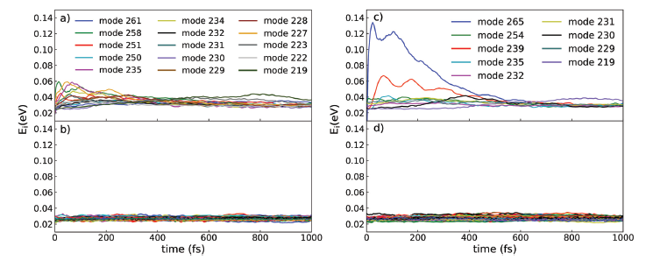
Vibrational energy redistribution during donor-acceptor electronic energy transfer:
Excited-State-Equilibrium Normal Modes (ES-ENM)
ES-ENM(S₁)
ES-ENM(S₂)
Vibrational energy associated to each
ES-ENM
The S₂→S₁ energy transfer takes place mainly through a unique ES-ENM(S₂) but once the system reaches the S₁ state the vibrational flux experiences a dispersion within a bunch of different directions.

Slide 11
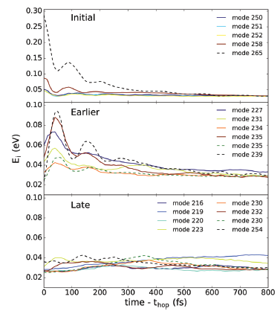
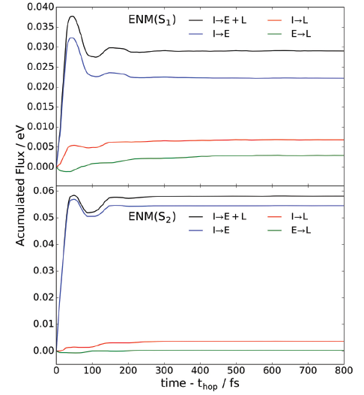
Vibrational energy redistribution during donor-acceptor electronic energy transfer:
Classification of normal modes-vibrational relaxation pathways
Statistical Minimum Flow method
“A method for analyzing the vibrational energy flow in biomolecules in solution”, M. A. Soler et al. J. Chem. Phys. 135, 204106 (2011)
The intramolecular vibrational energy relaxation and redistribution pathways allow us to classify the role of the different active normal modes.
“Vibrational energy redistribution during donor-acceptor electronic energy transfer: criteria to identify subsets of active normal modes” L. Alfonso-Hernandez et. al, Phys. Chem. Chem. Phys. ,22, 18454-18466 (2020)

Slide 12
Dendrimers
Highly branched conjugated macromolecules:
peripheral groups
Branched repeat units (layers)
a core
Unidirectional energy transfer:
periphery → core
Nanostar
Notes:
Such dendrimers are highly branched conjugated macromolecules with regular structures possessing numerous
peripheral groups, branched repeat units, and a core. Their unique architecture allows an efficient and controllable vectorial energy transport from the periphery to the core. In most cases, the branched repeat units act as selected photoactive chemical units that constitute a suitable media for the exciton transport and relaxation during the light-harvesting processes. Therefore, the detailed understanding of the unidirectional photoexcitation energy transfer between the repeat units inside a dendritic macromolecule is a very important goal in the field of organic photochemistry.

Slide 13
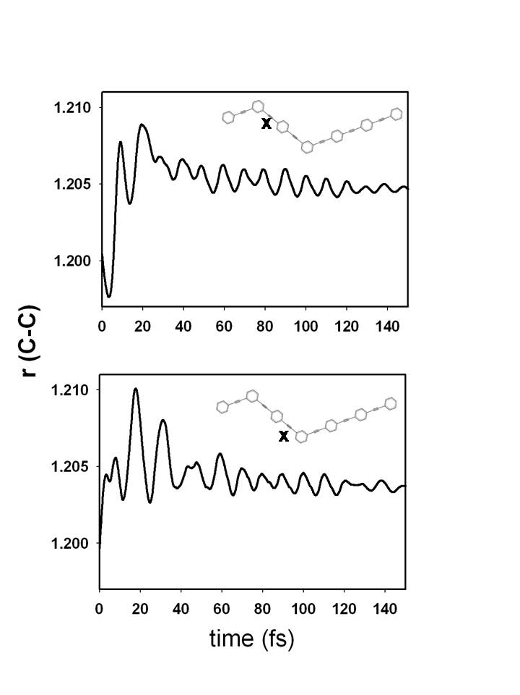
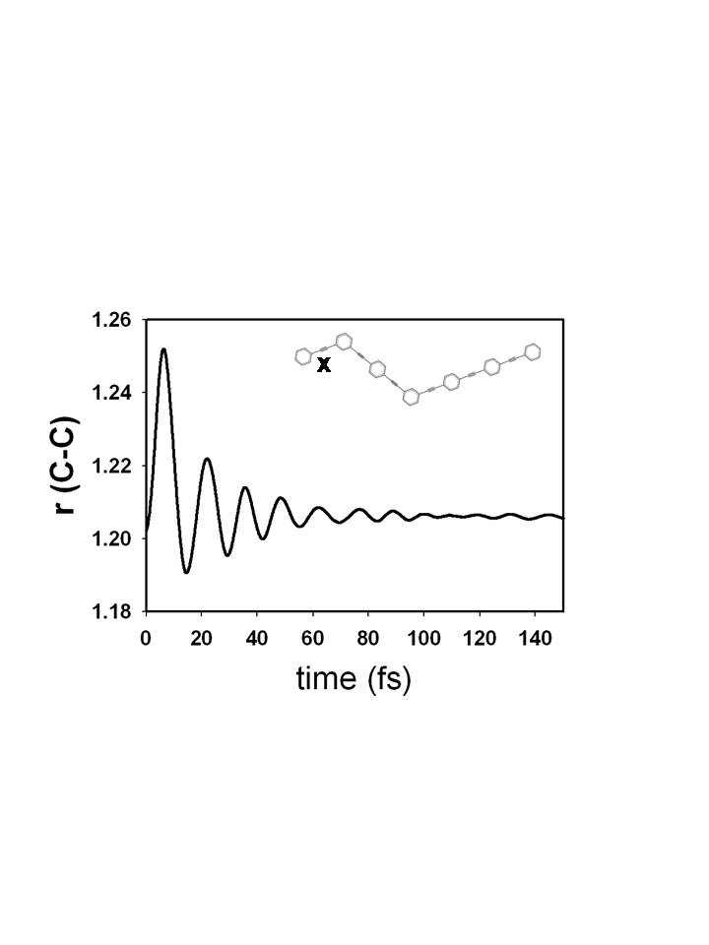
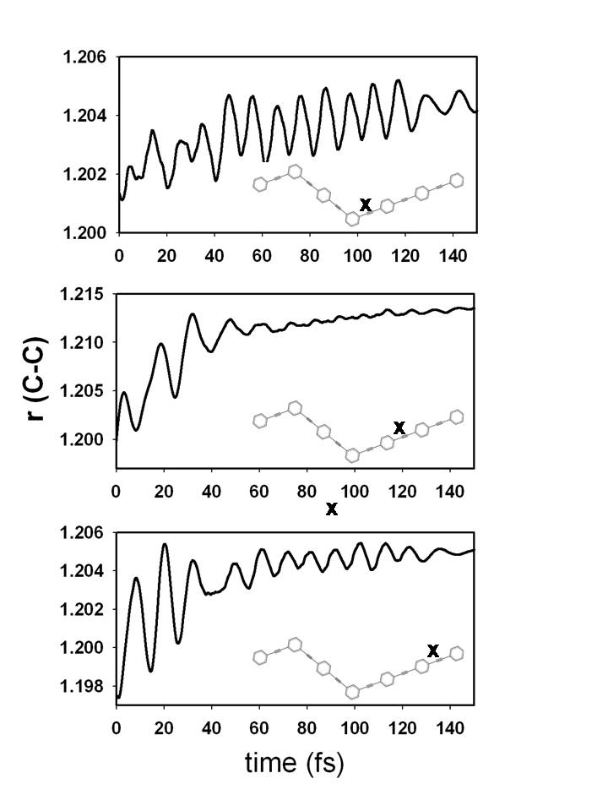
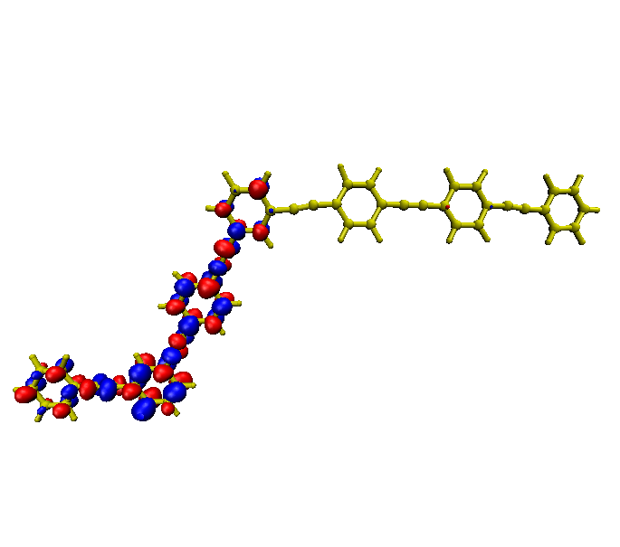
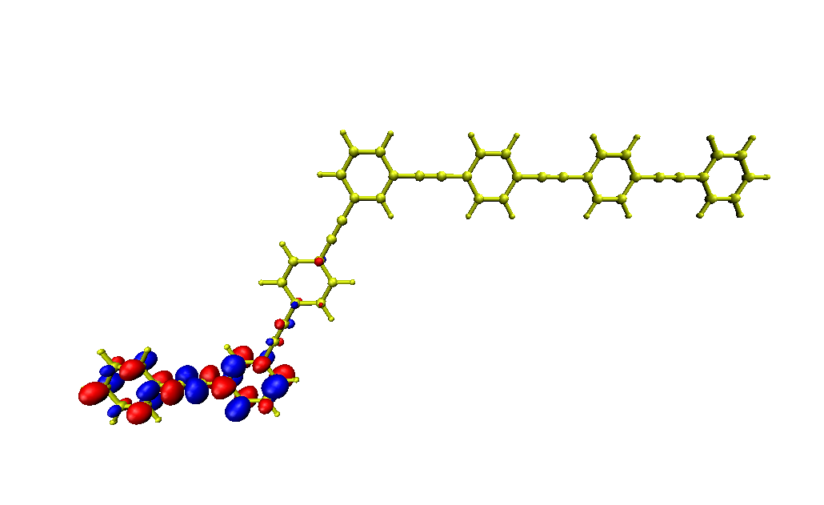
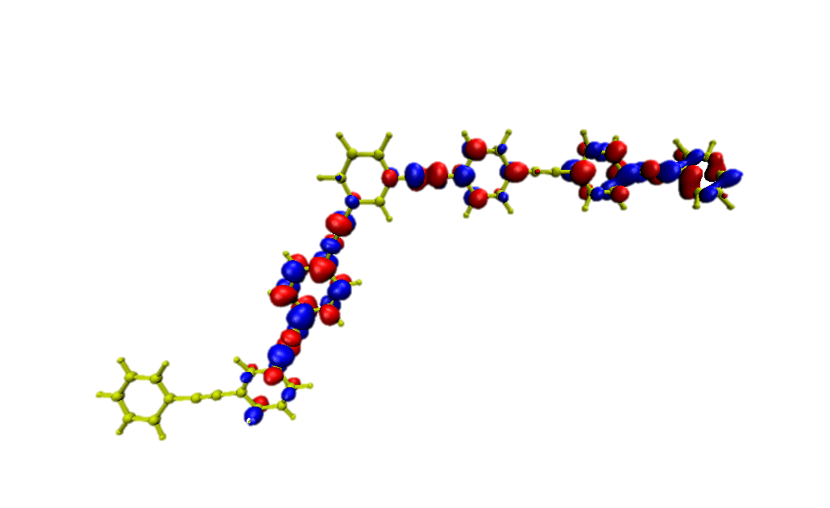
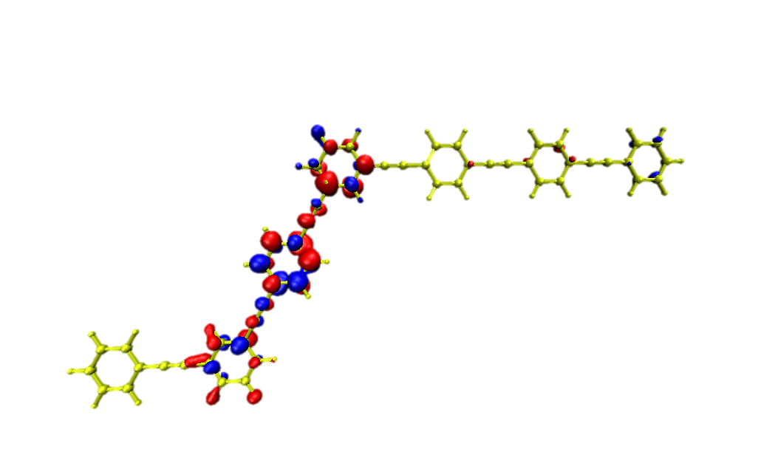
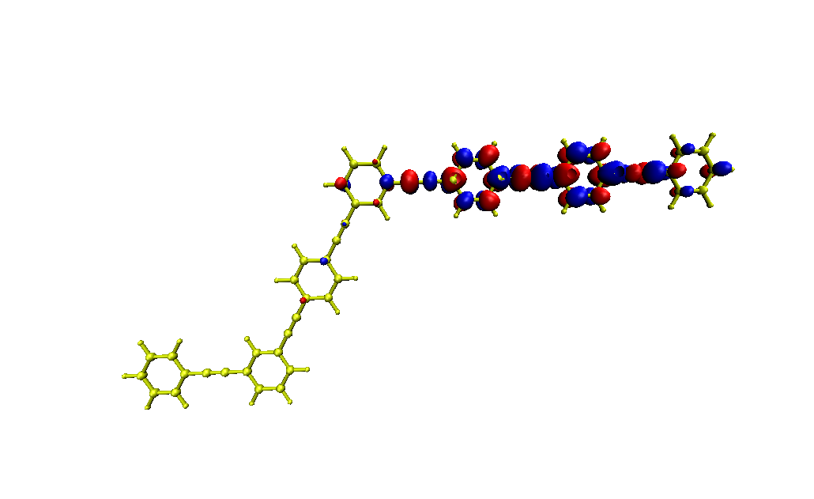
Unidirectional electronic and vibrational energy transfer
C≡C vibration
C≡C vibration
C≡C vibration
NACR(3,2)
NACR(2,1)
S₃
“Nonadiabatic Excited-State Molecular Dynamics: Modeling Photophysics in Organic Conjugated Materials”, T. Nelson et al. Acc. Chem. Res., 47(4), 1155-1164 (2014)
S₂
S₁
The vibrational energy relaxation is concomitant to the electronic energy relaxation.
S₀

Slide 14
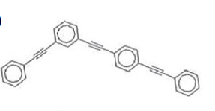
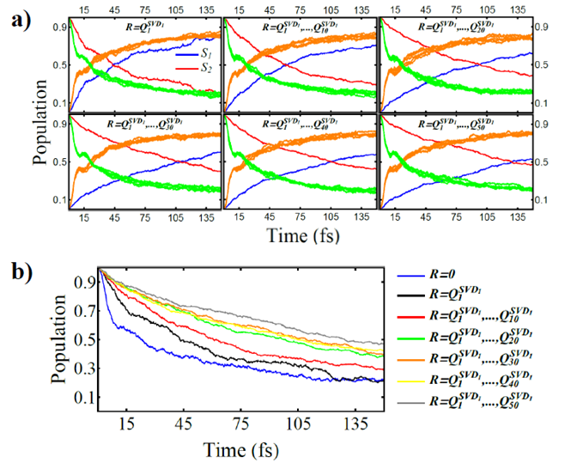
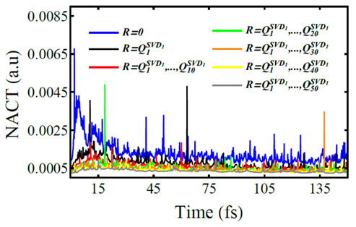
Photoinduced dynamics with constrained vibrational motion
FrozeNM algorithm
We apply normal mode constraints in NEXMD code:
ENM are constrained in decreasing order of overlap with NACR.
The relaxation rates can be
significantly reduced by freezing a well-defined small subset of active normal modes.
“Photoinduced dynamics with constrained vibrational motion: FrozeNM algorithm”
,H. Negrin-Yuvero et al, JCTC (submitted)

Slide 15
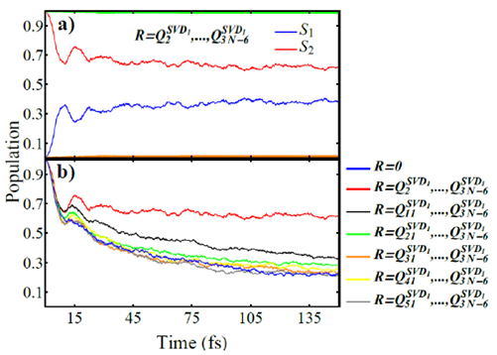
Photoinduced dynamics with constrained vibrational motion
FrozeNM algorithm
only a single nuclear degree of freedom is unfrozen
(the one that overlap the most with NACR)
systematically increasing the number of participating ENMs (selected in decreasing order of overlap with NACR)
Freezing normal modes is useful for guiding development of reduced dimensionality Hamiltonians that can be further used for more accurate treatment of non-adiabatic dynamics

Slide 16



Collaborators
Sergei Tretiak & Tammie Nelson
Adolfo Bastida
Stavros Athanasopoulos
Adrian Roitberg & Valeria Kleiman

Slide 17
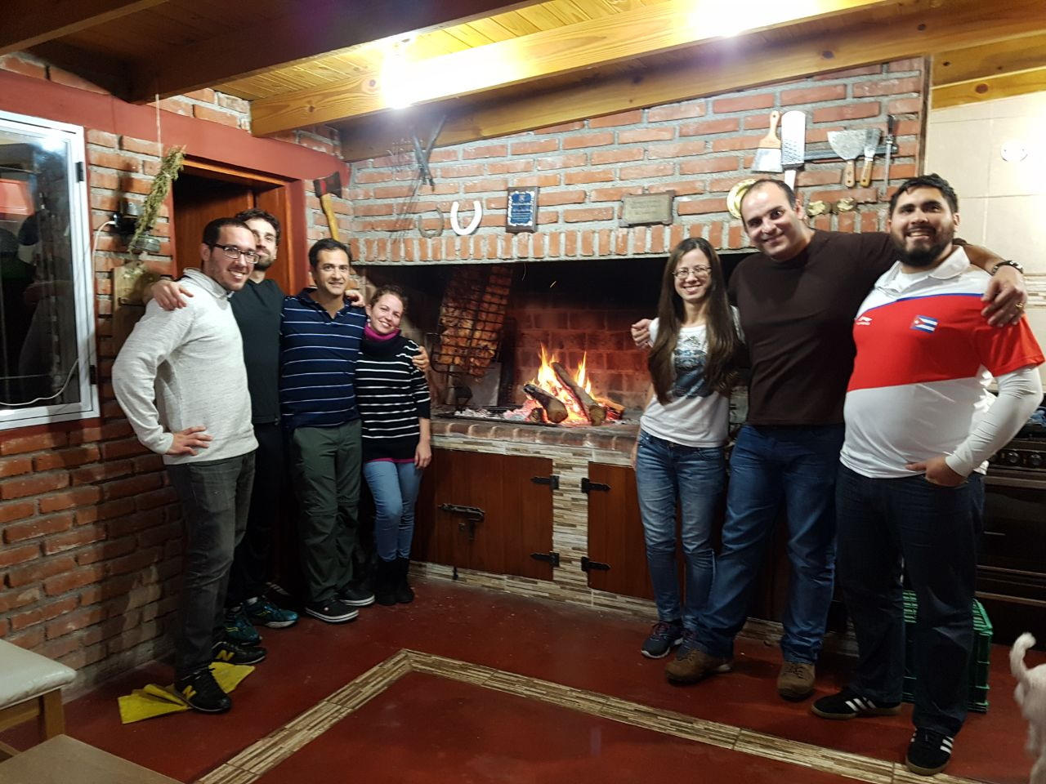
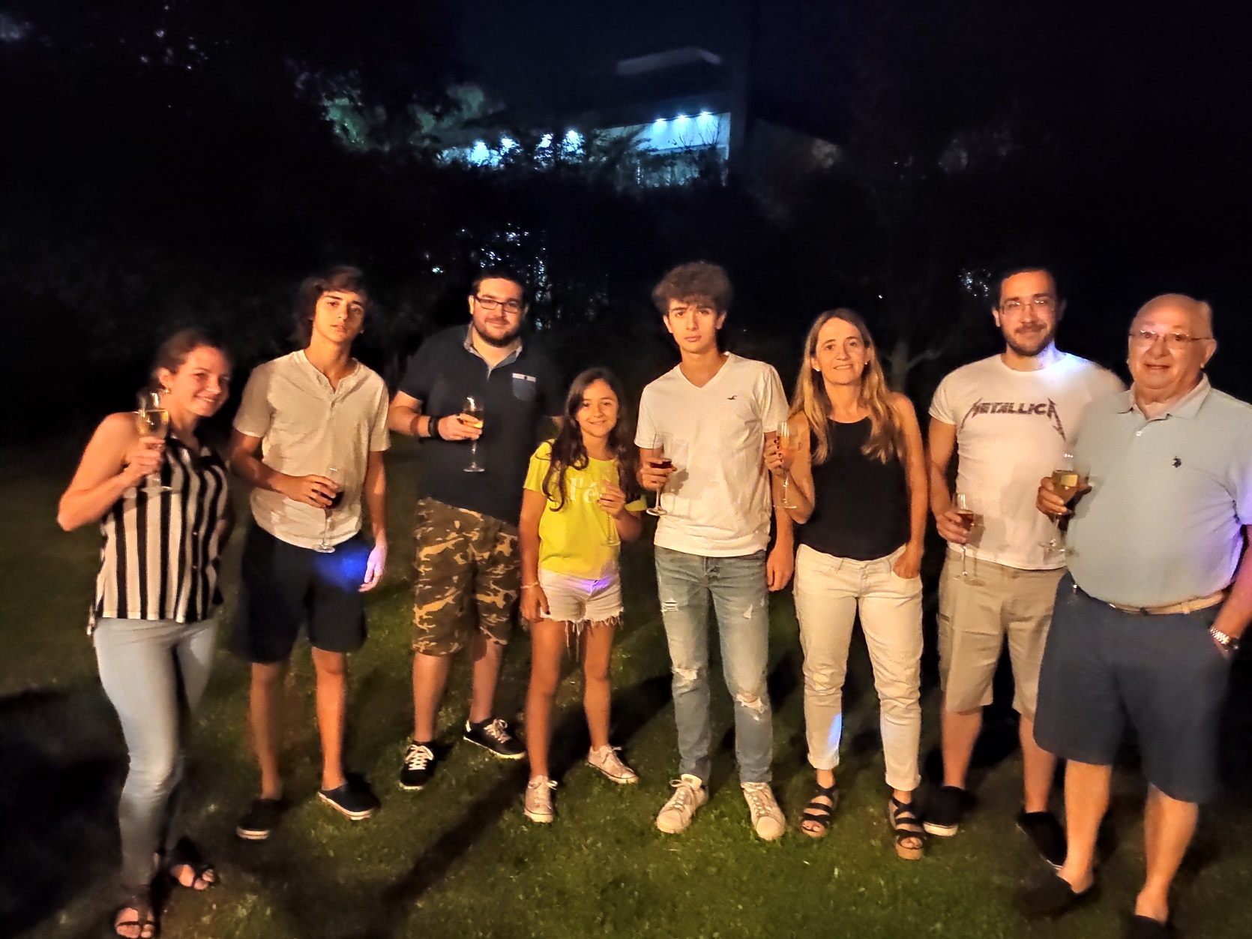
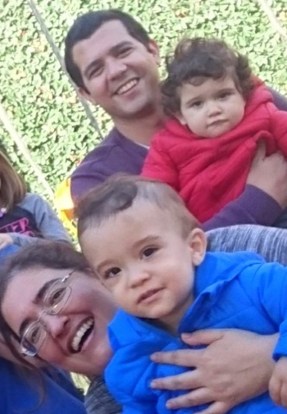



Molecular physics and Biophysics group
Patricio Barletta
Tadeo Saldaño
Me
Ricardo Franklin Mergarejo
Beatriz Rodriguez Hernandez
Dianelys Ondarse Alvarez
Victor Freixas
Javier Rios
Aliezer Martinez Mesa
Hassiel Negrin Yuvero
Nicolas Oldani
Llinersy Uranga Piña
http://ufq.unq.edu.ar/mpbg/

Slide 18
Collaborators
Main conclusions
Concomitant electronic and vibrational energy relaxation and redistribution
The intramolecular vibrational energy redistribution is not statistical
Active modes:
related to the direction of the non-adiabatic coupling
vector associated to different intramolecular energy relaxation pathways.
The rest of the modes act as a bath
FrozeNM: useful for guiding development of reduced dimensionality Hamiltonians

